Slide 1
Machine Vision: Example Tasks + Models
(with some content from “Understanding Deep Learning” Chapter 9)

Slide 2
Three Examples
Regularization
- Example: Ladder Networks [Rasmus 2015]
Learned embeddings
- Example: Box Embeddings [Rau 2020]
3D scan completion
- Example: Heightfields [Watson 2023]

Slide 3
Overview of Regularization
This work is subject to a Creative Commons CC-BY-NC-ND license. (C) MIT Press.

Slide 4
Fine-tuning a pre-trained network
y₁
y₂
y₃
Change one or more layers with a new training dataset!
x₁
x₂
x₃

Slide 5
Supervised Learning (Classification Example)
Test datum; what class?
Class A
Class B
Class unknown
x₂
x₁

Slide 6
Semi-Supervised Learning (Classification Example)
Test datum; what class?
Class A
Class B
Class unknown
x₂
x₁

Slide 7
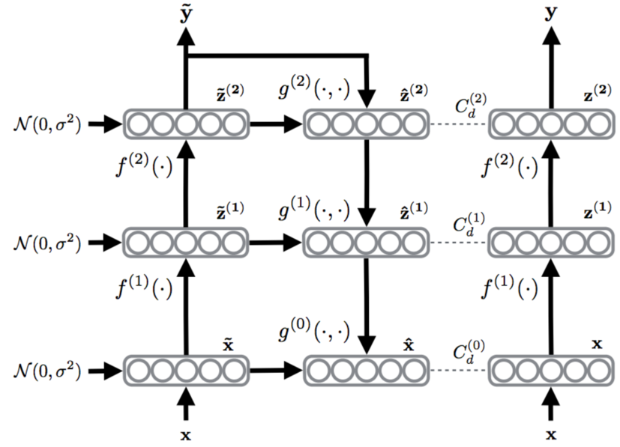
Example Semi-Supervised Network
Ladder Network [Rasmus et al. 2015]…
Label if available
Noise on weights

Slide 8
Example Semi-Supervised Network
Ladder Network [Rasmus et al. 2015]…
Autoencoder Loss
Label if available
Noise on weights

Slide 9
Three Examples
Regularization
- Example: Ladder Networks [Rasmus 2015]
Learned embeddings
- Example: Box Embeddings [Rau 2020]
3D scan completion
- Example: Heightfields [Watson 2023]

Slide 10
Triplet loss
Task: shape feature space s.t. images land near or far from each other, based on similarity
Distance D[x_{i}, x_{j}] = || f(x_{i}) – f(x_{j}) ||²
Loss L[x_{A}, x_{P}, x_{N}] = max[||x_{A}, x_{P}]||² - ||x_{A}, x_{N}]||² + α, 0]
Negative x_{N}
Anchor x_{A}
Positive x_{P}

Slide 11
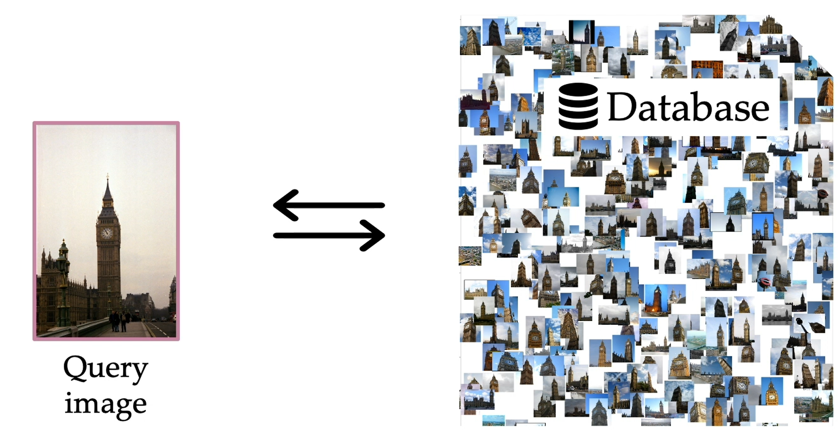
Predicting Visual Overlap of Images Through Interpretable Non-Metric Box Embeddings [Rau 2020]
Task: Net to predict visual overlap of 2 images

Slide 12
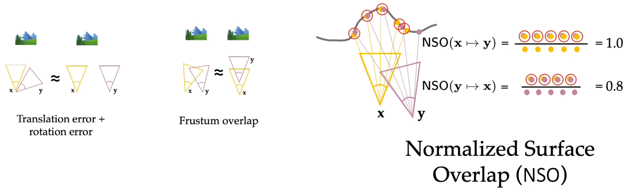
Normalized Surface Overlap
NSO assumes we have scene’s depth
Is not symmetric

Slide 13
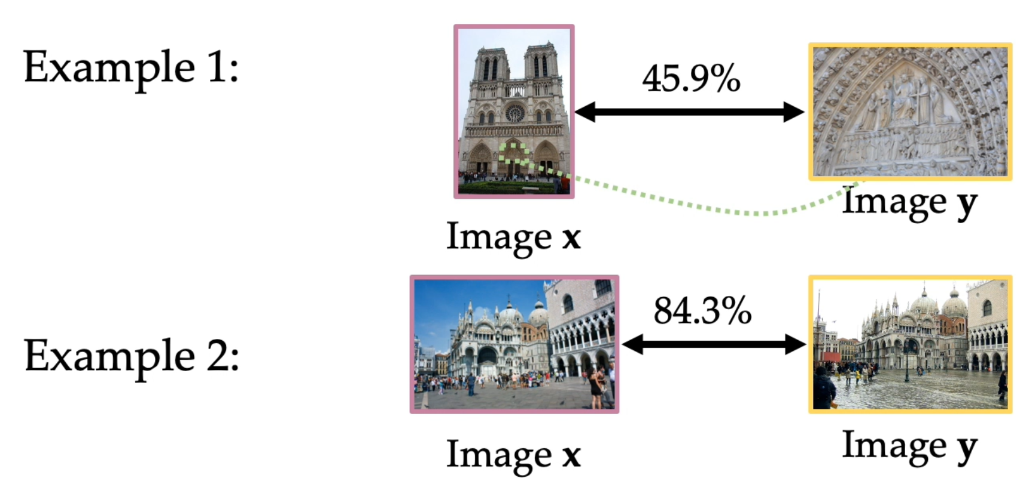
Normalized Surface Overlap
Averaging both NSO(x,y) and NSO(y,x) tells us something

Slide 14
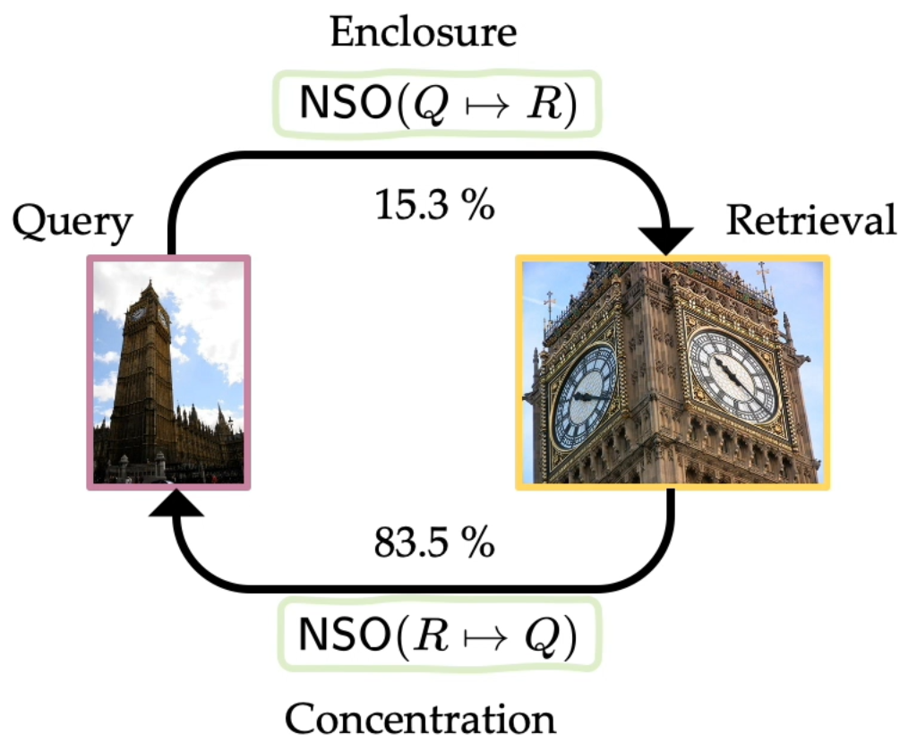
NSO is interpretable

Slide 15
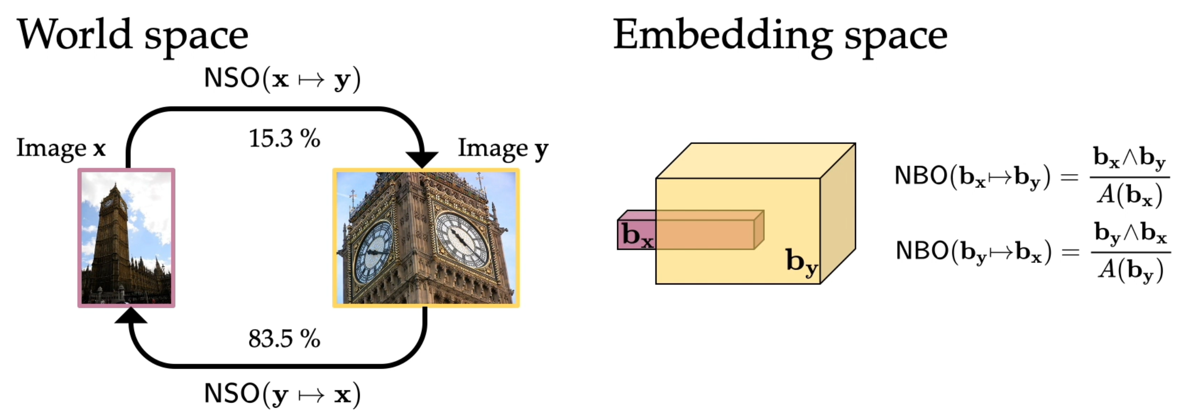
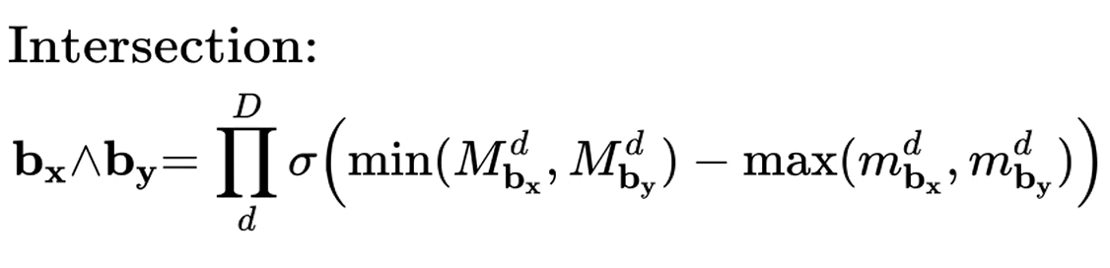
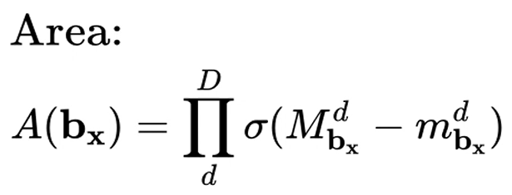
Normalized Box Embedding ≈ NSO
5 resid. layers + average pooling + 2 fully connected
Boxes are 32D
Batch size 32

Slide 16
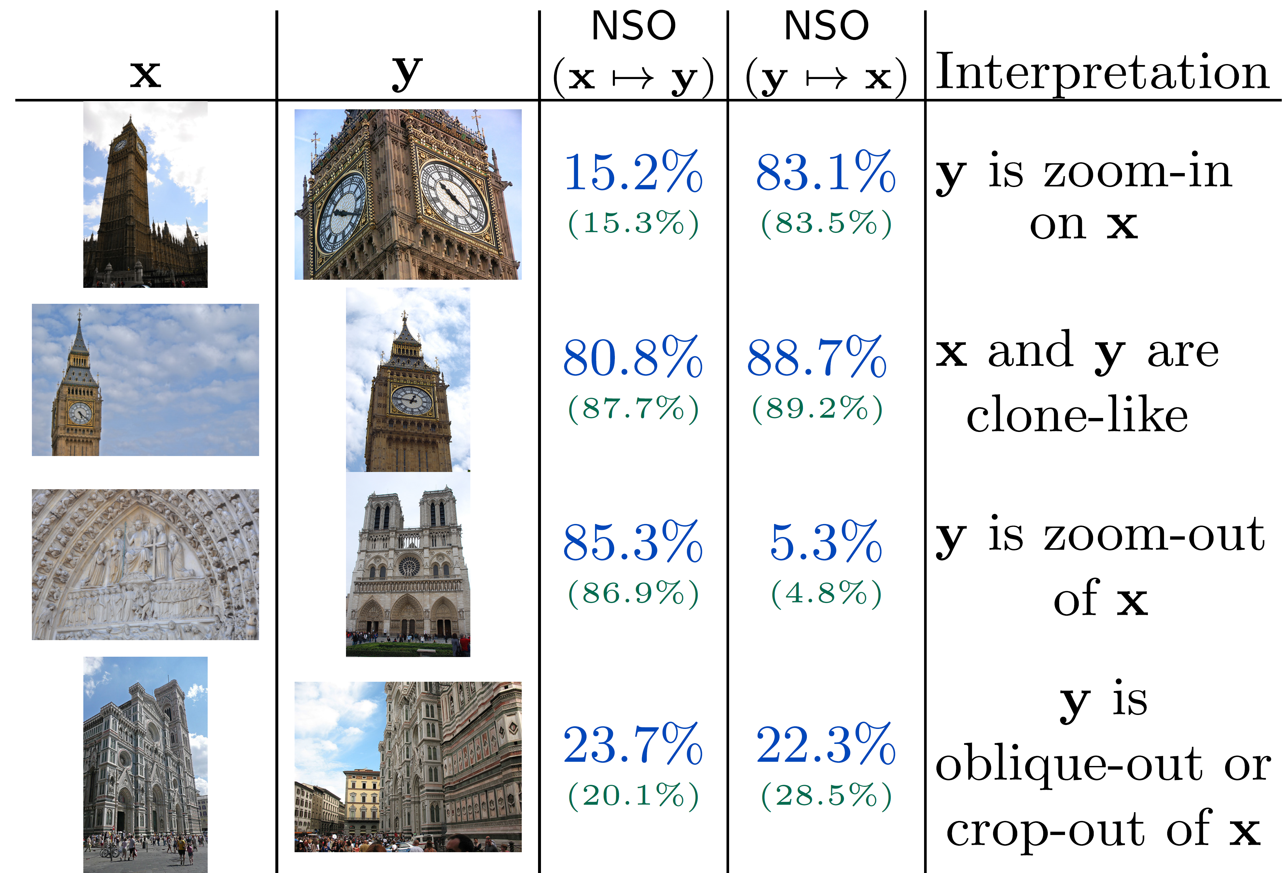
Inferred vs (true) NSO

Slide 17
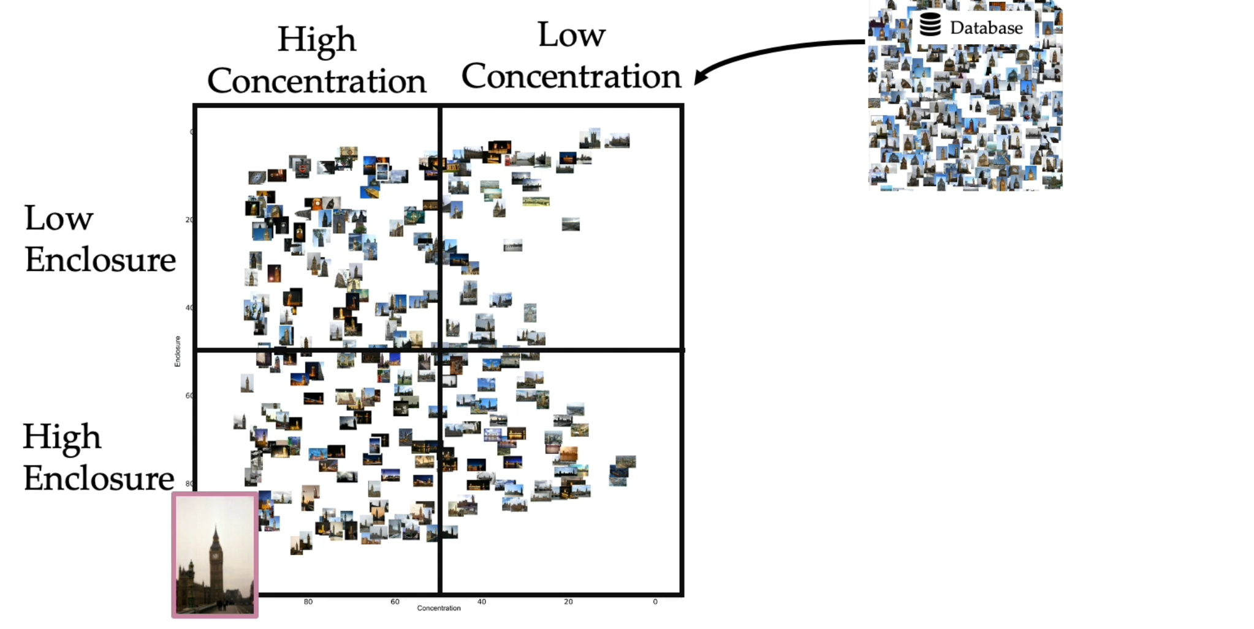
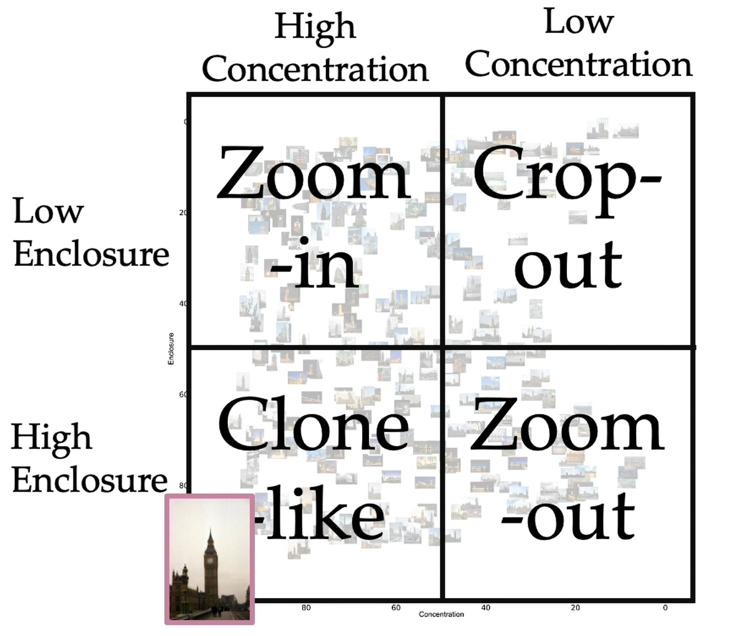
Paper + code are here

Slide 18
Three Examples
Regularization
- Example: Ladder Networks [Rasmus 2015]
Learned embeddings
- Example: Box Embeddings [Rau 2020]
3D scan completion
- Example: Heightfields [Watson 2023]

Slide 19

Heightfields project page

Slide 20
Predicting Depth
Task: Predict depth for every pixel of 1x RGB image
Input x: RGB
Output y: depth
See Eigen’2014
and Godard’2017’s Monodepth

Slide 21
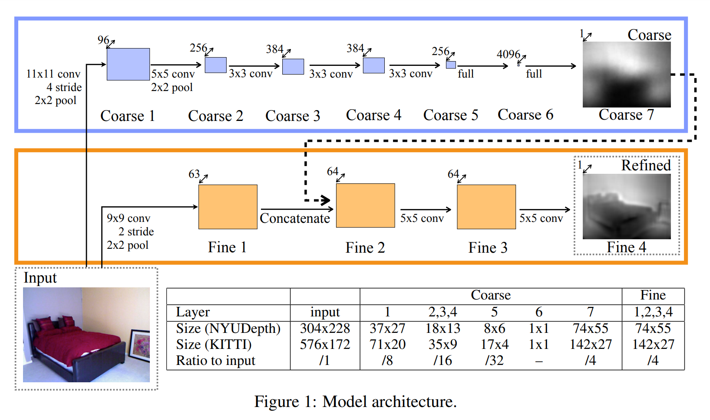
Predicting Depth
Task: Predict depth for every pixel of 1x RGB image
See Eigen’2014
and Godard’2017’s Monodepth

Slide 22
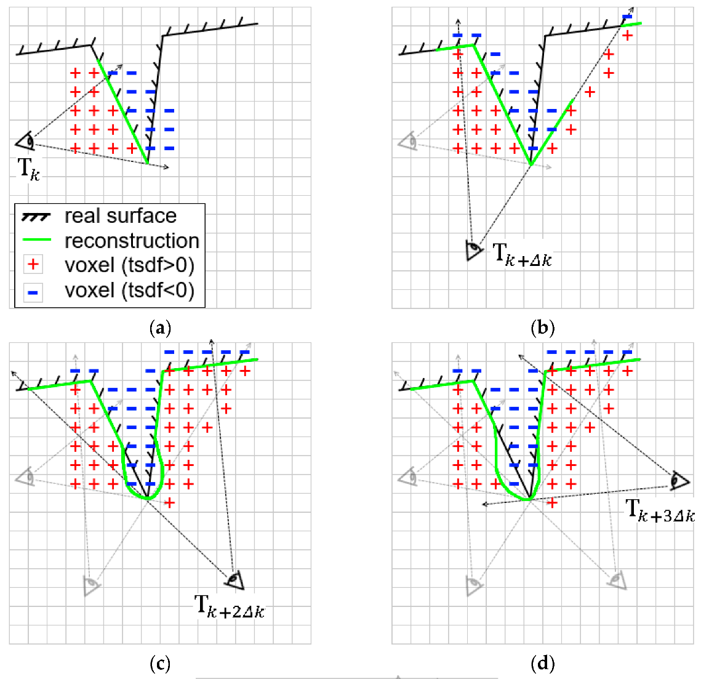
Depth Fusion
Task: Given multiple depth-maps with camera poses, fuse into 3D voxels using Truncated Signed Distance Function
Figure from CuFusion: Accurate Real-Time Camera Tracking and Volumetric Scene Reconstruction with a Cuboid, Zhang + Hu, Sensors 2017

Slide 23
Heightfields for Efficient Scene Reconstruction for AR [Watson 2023]
Task: In real-time, reconstruct the 3D scene geometry from sequence of posed RGB images.

Slide 24
Heightfields Model

Slide 25
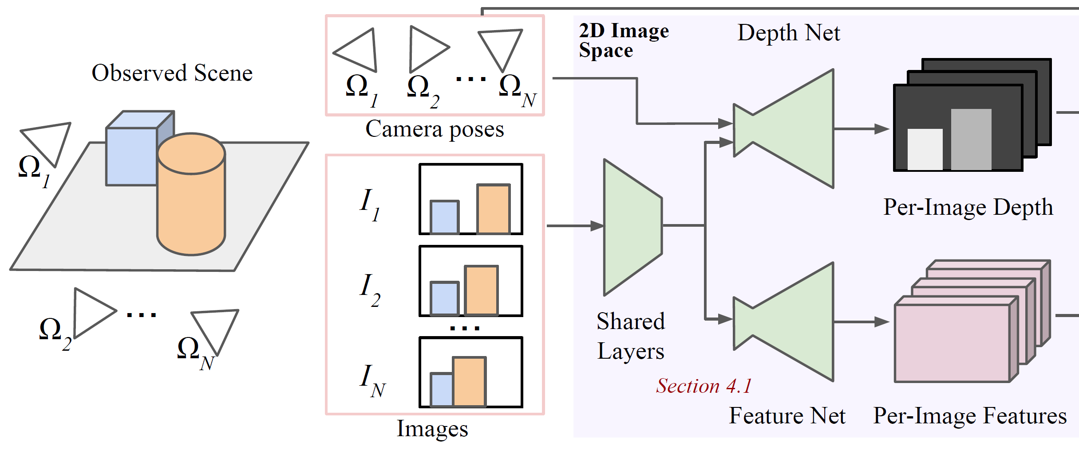
Heightfields Model
W x H x 32

Slide 26
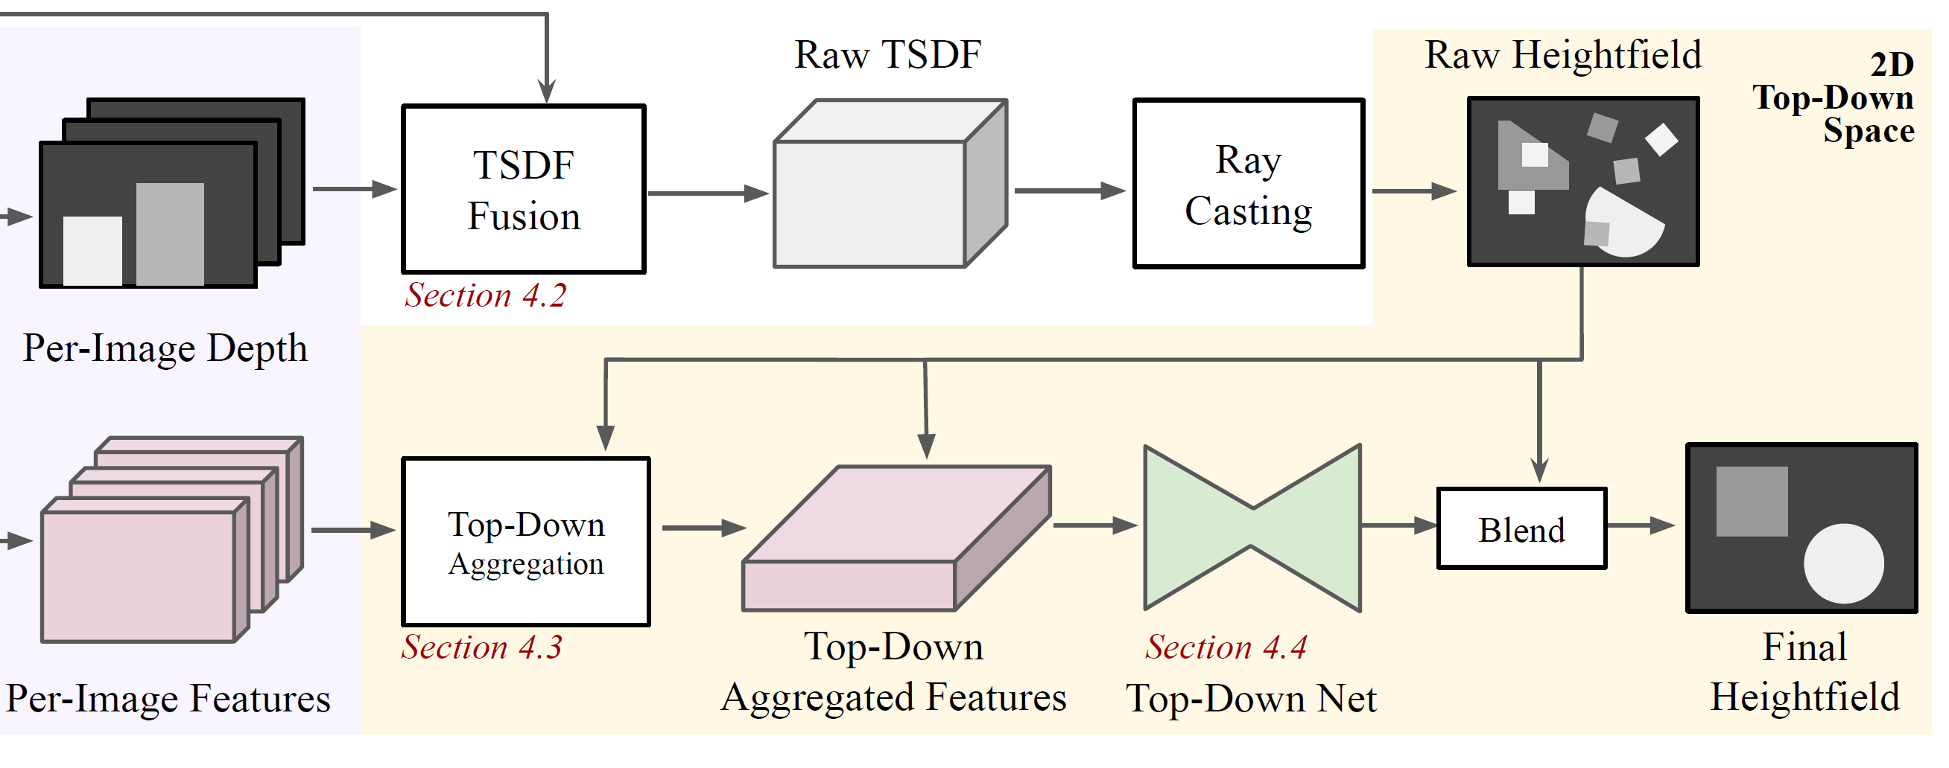
Heightfields Model

Slide 27
Heightfields’ top-down aggregation

Slide 28
Heightfields Results

Slide 29
Heightfields Results
Heightfields project page

Slide 30
Three Examples
Regularization
- Example: Ladder Networks [Rasmus 2015]
Learned embeddings
- Example: Box Embeddings [Rau 2020]
3D scan completion
- Example: Heightfields [Watson 2023]

Slide 31
Key Points
NN’s have many params and local minima, so regularization(s) are essential
Upstream, choose data-source carefully
Carefully consider what posterior probability or loss function you’re optimizing
Experience will teach you good ways of debugging + iterating
Start with the simplest model that may work for your task

Slide 32
Thank you!

